Slide 1
ATM Machine UML
By: Nathan Bemus, Alex Lang, Corey McLaughlin

Slide 2
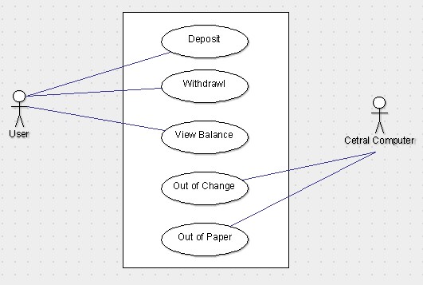
Use Case UML

Slide 3
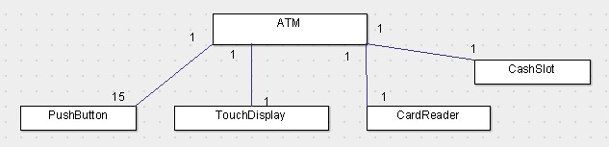
Class UML

Slide 4
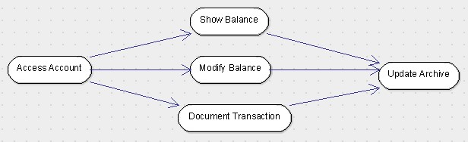
Activity UML

Slide 5
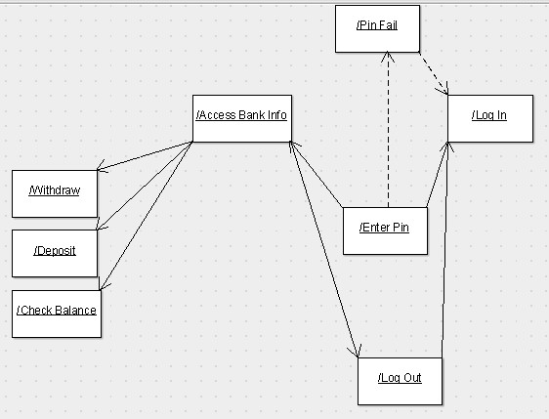
Interaction UML

Slide 6
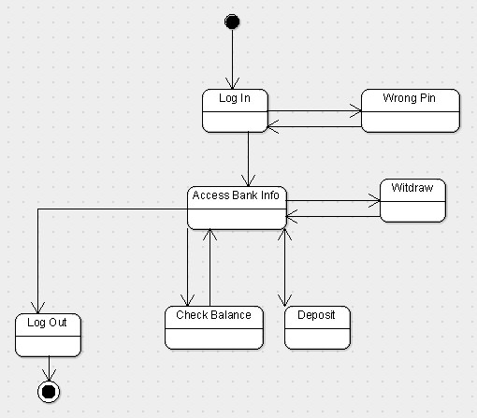
State Machine

